Slide 1





















Brainstorming - Arrays and Arraylists questions

Slide 2
























Brainstorming - Arrays and Arraylists questions

Slide 3










Brainstorming - Arrays and Arraylists questions

Slide 4









Brainstorming - Arrays and Arraylists questions
Rotate an array by K (left rotations)
Brute Force Approach:

Slide 5








Brainstorming - Arrays and Arraylists questions
Rotate an array by K (left rotations)
Better Approach:

Slide 6





Brainstorming - Arrays and Arraylists questions
Rotate an array by K (left rotations)
Optimised Approach:
K can be anything from 1 to infinity. Previous code does not work if the value is more than the size of array. An important observation is that when k>size of array(for size 6). If k=7, then after 6 rotations we get back the original array. So, 1 more rotation is required in the array, i.e., Rotate array by one. Hence to find it we use: k%n, the remainder obtained is the no of rotations required after x full rotations. Also, we have used three for loops in the previous implementation, and temp is an extra array, TC: O(n+k) and SC: O(k) (temp array). New approach increases the TC, but reduces the SC to zero.

Slide 7









Brainstorming - Arrays and Arraylists questions
Rotate an array by K (left rotations)
Optimised Approach:
K can be anything from 1 to infinity. Previous code does not work if the value is more than the size of array. An important observation is that when k>size of array(for size 6). If k=7, then after 6 rotations we get back the original array. So, 1 more rotation is required in the array, i.e., Rotate array by one. Hence to find it we use: k%n, the remainder obtained is the no of rotations required after x full rotations. Also, we have used three for loops in the previous implementation, and temp is an extra array, TC: O(n+k) and SC: O(k) (temp array). New approach increases the TC, but reduces the SC to zero.

Slide 8









Brainstorming - Arrays and Arraylists questions
Rotate an array by K (right rotations)
Brute-force Approach:

Slide 9








Brainstorming - Arrays and Arraylists questions
Rotate an array by K (right rotations)
Optimised Approach:

Slide 10














Brainstorming - Arrays and Arraylists questions
Move Zeros to End

Slide 11







Brainstorming - Arrays and Arraylists questions
Move Zeros to End

Slide 12
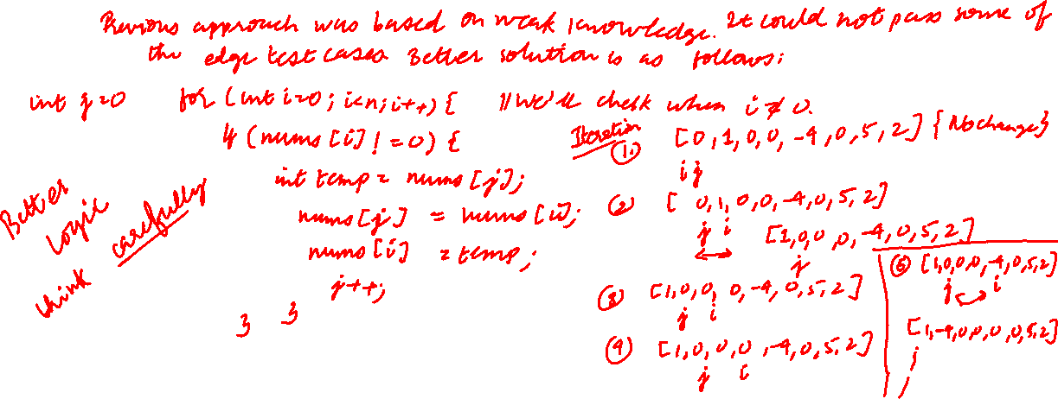
Brainstorming - Arrays and Arraylists questions
Move Zeros to End

Slide 13











Brainstorming - Arrays and Arraylists questions
Remove duplicates from sorted array
An array sorted in non-decreasing order is an array where every element to the right of an element in either equal to or greater in value than that element.

Slide 14





Brainstorming - Arrays and Arraylists questions
Remove duplicates from sorted array
An array sorted in non-decreasing order is an array where every element to the right of an element in either equal to or greater in value than that element.

Slide 15

Brainstorming - Arrays and Arraylists questions
Remove duplicates from sorted array
An array sorted in non-decreasing order is an array where every element to the right of an element in either equal to or greater in value than that element.

Slide 16
Brainstorming - Arrays and Arraylists questions
Find Missing Number

Slide 17
Brainstorming - Arrays and Arraylists questions
Union of two Sorted Arrays

Slide 18
Brainstorming - Arrays and Arraylists questions
Intersection of two sorted arrays

Slide 19
Brainstorming - Arrays and Arraylists questions

Slide 20
Brainstorming - Arrays and Arraylists questions

Slide 21
Brainstorming - Arrays and Arraylists questions

Slide 22
Brainstorming - Arrays and Arraylists questions

Slide 23
Brainstorming - Arrays and Arraylists questions

Slide 24
Brainstorming - Arrays and Arraylists questions

Slide 25
Brainstorming - Arrays and Arraylists questions

Slide 26
Brainstorming - Arrays and Arraylists questions

Slide 27
Brainstorming - Arrays and Arraylists questions

Slide 28
Brainstorming - Arrays and Arraylists questions

Slide 29
Brainstorming - Arrays and Arraylists questions

Slide 30
Brainstorming - Arrays and Arraylists questions

